Slide 1
LEARNING OUTCOME 3
Business and the Business Environment

Slide 2

LEARNING OUTCOME 3
Use contemporary examples to demonstrate both the positive and negative influence/impact the macro environment has on business operations

Slide 3

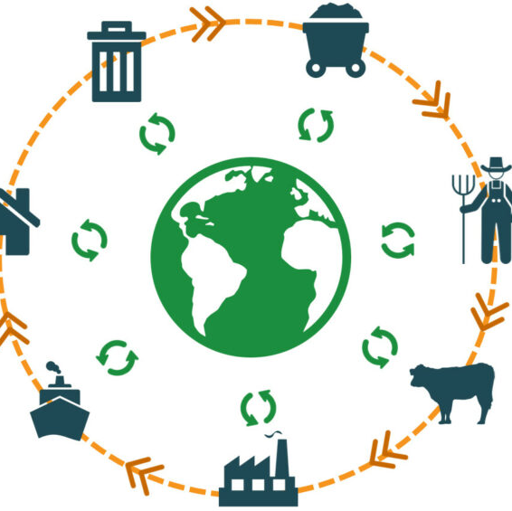

Key Learning
The macro factors that influence and impact on business activities
The context of the macro environment
Organisation operations

Slide 4
What are the context of the macro Environment
The macro-environment refers to the broader condition of an economy as opposed to specific markets.
The macro-environment can be affected by GDP, fiscal policy, monetary policy, inflation, employment rates, and consumer spending.

Slide 5
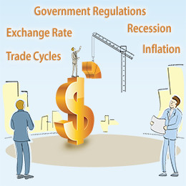
Political factors
Political factors refer to the impact of government policies, regulations, and laws on an organization's operations, strategies, and decision-making.
These factors can be both internal and external to an organization and can vary widely across different countries and regions.
Examples:
Government stability and political risks: Changes in government policies or instability in the political environment can impact an organization's operations, particularly if it operates in countries with high levels of political risk.
Taxation policies: Taxation policies can have a significant impact on an organization's profitability and ability to invest in new projects
Trade regulations and policies: Trade regulations and policies can affect an organization's ability to import or export goods and services, impacting its supply chain and revenue streams

Slide 6
Political factors that influence and impact the business:
Government policies and regulations:
Government policies and regulations can have a significant impact on businesses.
For example, changes in tax policies, trade policies, and labour laws can affect a business's profitability and operations.
2.Political stability:
A stable political environment can help businesses make long-term plans and investments, while political instability can lead to uncertainty and risk.
3.Political ideology:
The political ideology of a government can also affect businesses.
For example, a government that favours free-market policies may have different regulations and incentives than one that favours more government intervention.
4.Political corruption:
Corruption can make it difficult for businesses to operate and compete fairly, as corrupt officials may demand bribes or favour certain companies over others.
5.Political conflicts:
Political conflicts, such as wars or trade disputes, can disrupt supply chains and affect business operations.

Slide 7
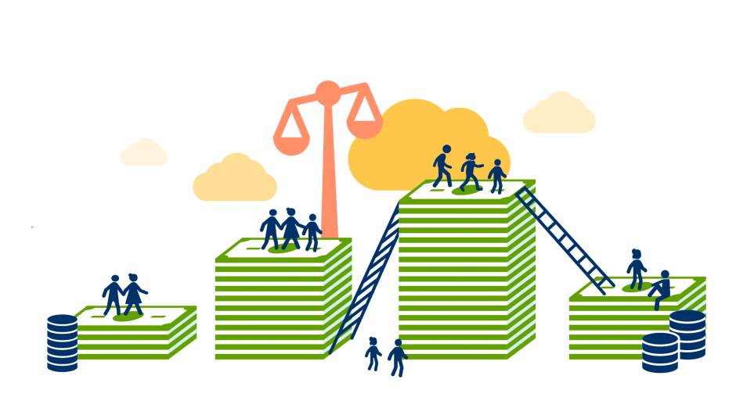
Economic factors
Economic factors are factors that relate to the economy as a whole and can impact :
businesses
Industries
Education
employment status
income.
consumers.
Examples:
Market conditions:
The overall state of the economy, including factors such as inflation, interest rates and unemployment rates, can impact businesses
Consumer behaviour:
Consumer behaviour, such as purchasing power, spending habits, and preferences can impact businesses.
Global economic conditions:
Global economic conditions, such as changes in international trade policies or currency exchange rates, can affect businesses that operate in international markets.

Slide 8
Economic factors that influence and impact the business environment
There are several economic factors that can influence and impact the business environment.
1.Inflation:
Inflation is the rate at which prices for goods and services increase over time. High inflation can lead to higher costs for businesses, which can impact their profitability and operations.
2.Interest rates:
Interest rates can impact businesses in several ways, such as by affecting borrowing costs, investment decisions, and consumer spending.
3.Economic growth:
The overall level of economic growth can impact businesses, as a strong economy can lead to increased demand for goods and services.
4.Exchange rates:
Exchange rates can impact businesses that operate in international markets, as changes in currency values can impact export and import costs.
5.Labour costs:
Labour costs, including wages and benefits, can impact businesses, particularly in industries that rely heavily on labour

Slide 9
Social factors
Social factors are the things that affect the habits and spending of customers.
Social factors refer to the cultural, demographic, and societal trends that can impact businesses.
Examples
Demographic trends:
Demographic factors such as age, gender, and ethnicity can impact businesses, as they can affect the demand for products and services.
2.Cultural factors:
Cultural factors such as values, beliefs, and attitudes can impact businesses, as they can affect consumer behaviour and preferences.

Slide 10
Social factors that can influence and impact the business environment
1.Lifestyle trends:
Lifestyle factors such as health and wellness, environmentalism, and technology adoption can impact businesses, as they can affect consumer preferences and demand.
2.Education levels:
Education levels can impact businesses, as they can affect the availability of skilled workers and the level of demand for certain products and services.
3.Income levels:
Income levels can impact businesses, as they can affect the purchasing power of consumers and the demand for certain products and services.
4.Social media:
Social media has become an influential factor in the business environment, as it can affect consumer behaviour, reputation management, and marketing strategies.

Slide 11
Technological factors
Technological factors refer to the external factors that influence a business or organization's operations and decision-making processes, which are related to technological advancements and innovations.
These factors can have a significant impact on businesses' success or failure, depending on how well they adapt and utilize the latest technologies
Examples
Innovation:
The ability to innovate and develop new technologies can give a business a competitive advantage.
2.Automation:
The increasing use of automation and artificial intelligence (AI) can improve efficiency and productivity, but may also lead to job losses.
3.Technology infrastructure:
The availability and quality of technology infrastructure, such as internet connectivity and telecommunications, can impact a business's ability to operate.

Slide 12
Technological factors that influence and impact the business environment:
1.Rapid technological change:
The rapid pace of technological change can impact businesses by making their products or services obsolete.
It's important for businesses to keep up with the latest technological advancements and continuously innovate to stay relevant.
2.Advancements in communication technologies:
Advances in communication technologies such as social media, video conferencing, and messaging apps have made it easier for businesses to communicate with their customers, suppliers, and partners.
3.Digitalization:
The shift towards digitalization has changed the way businesses operate, making it easier to collect and analyze data, automate processes, and reach customers through digital channels.
4.Automation and artificial intelligence:
Automation and artificial intelligence (AI) can help businesses improve efficiency and productivity, but may also lead to job losses.
5.Cybersecurity threats:
As businesses rely more on technology, they become more vulnerable to cybersecurity threats such as hacking, data breaches, and cyber-attacks. It's important for businesses to protect their data and systems from these threats.

Slide 13
Legal factors
Legal factors are external factors that impact a business or organization's operations and decision-making processes, related to laws, regulations, and policies enacted by governments or other regulatory bodies.
These factors can significantly impact businesses, and it's important to understand and comply with them to avoid legal issues or penalties.
Example
Employment laws:
Laws and regulations related to employment, such as minimum wage requirements, employee benefits, and anti-discrimination policies,
2.Consumer protection laws:
Consumer protection laws, such as regulations on product safety, pricing, and advertising
3.Intellectual property laws:
Intellectual property laws, such as patents, trademarks, and copyrights, can protect a business's

Slide 14
Legal factors that influence and impact the business environment
Health and safety laws:
Health and safety laws, such as workplace safety regulations, can affect a business's ability to provide a safe working environment for employees.
2.Data protection and privacy laws:
Laws related to data protection and privacy, such as the General Data Protection Regulation (GDPR), can affect a business's ability to collect, store, and use customer data.
3.Environmental laws:
Environmental laws, such as regulations on emissions and waste disposal, can affect a business's ability to operate in a sustainable and responsible manner.
4.Taxation laws:
Taxation laws, such as income tax and sales tax regulations, can affect a business's profitability and financial stability.

Slide 15
Environmental factors
Environmental factors are external factors that can impact a business's operations and decision-making processes. These factors are related to the natural environment and can include both opportunities and threats.
Example:
Climate change:
Climate change can affect businesses in various ways, such as by changing weather patterns, increasing the frequency and intensity of natural disasters, and affecting the availability of natural resources.
2.Natural resources:
Businesses may rely on natural resources such as water, energy, and raw materials to operate, and their availability and cost can affect a business's operations and profitability.

Slide 16
Environmental factors that influence and impact the business environment
Climate change:
Climate change and its related impacts, such as extreme weather events and sea level rise, can have significant impacts on businesses, especially those in sectors such as agriculture, tourism, and construction.
2.Resource depletion:
The depletion of natural resources, such as water, minerals, and fossil fuels, can have a significant impact on businesses that rely on these resources.
This can lead to higher costs and supply chain disruptions.
3.Environmental regulations:
Regulations aimed at protecting the environment can impact businesses by increasing compliance costs and changing the way they operate.
For example, regulations on carbon emissions can impact industries such as energy and transportation.
4.Consumer preferences:
Consumers are increasingly interested in environmentally sustainable products and services.

Slide 17
The PESTLE framework as an analytical tool to monitor and forecast external influences
The PESTLE framework is a widely used analytical tool that businesses can use to monitor and forecast external influences on their operations.
The acronym PESTLE stands for Political, Economic, Sociocultural, Technological, Legal, and Environmental factors.
By using the PESTLE framework, businesses can identify the key external factors that may impact their operations, and develop strategies to mitigate the risks or take advantage of opportunities
L.

Slide 18
The macro factors that influence and impact on business activities
There are several macro factors that can influence and impact business activities. These macro factors are external to the business and can have a significant impact on its operations.

Slide 19
There are several macro factors that can influence and impact business activities, including
Economic factors, such as economic growth, inflation, interest rates, and consumer spending patterns, can have a significant impact on business activities.
The pace of technological change can significantly impact businesses. Technological factors include automation, innovation, and advancements in information technology
Social trends and demographic changes can impact businesses. These factors include changes in consumer behaviour, population growth, and shifts in cultural norms.
Economic factors
Technological factors
Social factors
Political factors
Environmental factors
Legal factors
Government policies and regulations can have a major impact on businesses. These factors include tax policies, trade restrictions, and labour laws.
Environmental factors such as climate change, pollution, and resource depletion can have a significant impact on businesses. Companies may be required to adopt sustainable practices and reduce their carbon footprint.
Laws and regulations, such as data protection and consumer protection laws, can impact businesses.

Slide 20

Data and analytics play a crucial role in digital advertising. They provide advertisers with insights about their target audience, allowing them to create more effective ad campaigns and reach their desired audience more efficiently. With data and analytics, advertisers can measure the performance of their campaigns and make informed decisions about where to allocate their advertising budgets.
Digital advertising refers to the practice of promoting products or services through digital channels, such as search engines, social media, and websites. The main advantage of digital advertising is its ability to reach a large and diverse audience in a cost-effective manner. With the right targeting and messaging, digital advertising can drive significant traffic and sales for businesses of all sizes.
Digital Advertising

Slide 21
The growth of data analytics and business intelligence using Big Data
The growth of data analytics and business intelligence using big data has been a significant trend in recent years. With the massive amounts of data generated by businesses and consumers, it has become increasingly important to have tools and technologies that can extract insights and value from this data. Big data analytics and business intelligence provide businesses with the ability to make data-driven decisions that can help them improve their operations, identify new opportunities, and stay ahead of the competition

Slide 22
Cybersecurity and data protection have also become increasingly important as more businesses move their operations online and store sensitive data in digital formats.
With the rise of cyber threats, businesses need to take measures to protect their data and systems from malicious attacks.
Cybersecurity technologies, such as firewalls, intrusion detection systems, and encryption, can help businesses safeguard their data and prevent unauthorized access.
Data protection has also become a key issue as businesses collect and store more data about their customers and employees. Data protection regulations, such as the EU's General Data Protection Regulation (GDPR) and the California Consumer Privacy Act (CCPA), require businesses to take measures to protect personal data and give individuals more control over their data.
This has led to the rise of data protection technologies, such as data encryption and anonymization, to help businesses comply with these regulations and protect sensitive information
The rise of cybersecurity and data protection

Slide 23

Here are some key ways in which it has affected the world:
The impact of globalisation
Globalization has had a profound impact on the world in the past few decades.
Increased trade:
Globalization has led to an increase in international trade, as companies seek to take advantage of lower labour costs and expanded markets.
This has led to a rise in economic activity and job creation in many countries.
2.Cultural exchange:
Globalization has led to a greater exchange of culture and ideas between different parts of the world.
This has led to greater understanding and tolerance between people of different races, religions, and cultures.
3.Improved technology:
Globalization has accelerated the spread of new technologies, such as the internet and social media, which have revolutionized communication and information sharing
4.Environmental impact:
Globalization has led to an increase in the production and consumption of goods and services, which has had a significant impact on the environment.

Slide 24
Organisation operations
Organizational operations refer to the day-to-day activities and processes that enable an organization to function effectively and achieve its goals.
These operations can include:
Production and manufacturing:
These operations involve the creation of goods and services through the use of labour, materials, and equipment.
2.Sales and marketing:
These operations involve the promotion and sale of goods and services to customers.
3.Logistics and supply chain management:
These operations involve the planning, coordination, and management of the movement of goods and services from suppliers to customers
4. Human resources management:
These operations involve the recruitment, training, and management of employees to ensure that the organization has the necessary skills and resources to achieve its goals.

Slide 25
Dealing with unexpected crises that affect business operations and activities
Unexpected crises can have a significant impact on business operations and activities.
Here are some strategies that organizations can use to deal with unexpected crises:
Develop a crisis management plan:
Organizations should develop a crisis management plan that outlines the roles and responsibilities of key stakeholders, communication protocols and contingency plans.
1
Identify and assess risks:
Organizations should regularly assess their operations and activities to identify potential risks and vulnerabilities.
2
Communicate effectively:
Effective communication is essential during a crisis. Organizations should communicate quickly, clearly, and frequently with employees, customers, suppliers, and other stakeholders.
3

Slide 26
Summary
The macro environment can have both positive and negative impacts on business operations.
Businesses that are able to adapt to changing market conditions and prioritize values such as sustainability, diversity, and inclusion are more likely to thrive in the long term.
However, businesses that are unable to adapt to changing market conditions or that are impacted by political instability and trade conflicts may struggle to maintain their operations.
Positive Impact:
Increased Focus on Sustainability
The growing concern for environmental sustainability has led to a positive impact on businesses. For example, companies such as Tesla have capitalized on the increased demand for electric vehicles, with their sales soaring in recent years.
Other companies, such as Patagonia, have built their brand around sustainability and environmental responsibility, appealing to consumers who prioritize these values.
Negative Impact: COVID-19 Pandemic
The COVID-19 pandemic has had a significant negative impact on businesses around the world.
The pandemic has disrupted global supply chains, forced businesses to shut down, and resulted in significant job losses.
Many businesses have struggled to adapt to the new reality of remote work, and many small businesses have been forced to close permanently.

Slide 27
Thank You

